Slide 1
Car identification using deep learning
PickCar
Kerem Buyukdereli
Onat Yapici

Slide 2
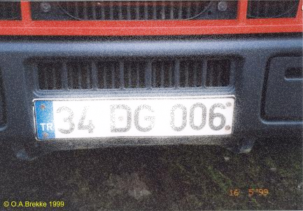
Problem
Currently car identification in Turkey is based on license plates in front and back of each car. Some of the problems bounded to using only license plates for identification can be listed as:
not always in the same height or angle
some drivers put them inside their cars
can be easily obscured with snow and other external effects.
difficult to capture while the vehicle is turning
These inadequacies cause wrong license plate numbers to be identified and sometimes lead to wrongly issued (Larson, n.d.)traffic tickets. This problem can be averted by utilizing a cross check with car model and brand using the neural network we trained.

Slide 3








Which datasets did we go through?
We first focused on making a car picking algorithm. Which led us to car’s own brand websites. (Reading data from websites: vw.com, group.renault.com)
Later we decided to make a project based on identifying cars. However the brands were not as broad as we would like. (Stanford Cars Dataset)
We finally focused on a project that would also be useful in Turkey by choosing the most widespread models of the most prominent brands in Turkey. (Bing Image Search API v7|Microsoft Cognitive Services)

Slide 4
What were potential pros/cons?
Websites
Most updated and reliable information
The conventional terms can be used to extract information
Different websites have different formatting
Stanford Car Dataset
A lot of cars and classes
Classified and used before by many others
It is easily accessible
Not enough photos of a single car brand
Bing Image Search API
All kind of pictures from all possible angles
Can be queried by prominent colors
Unwanted search terms can be excluded
Lots of confusion from other related queries

Slide 5
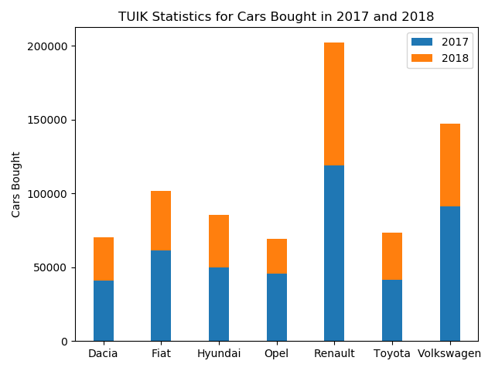
Choosing Car Brands and Models

Slide 6
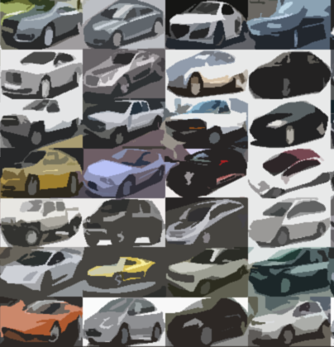
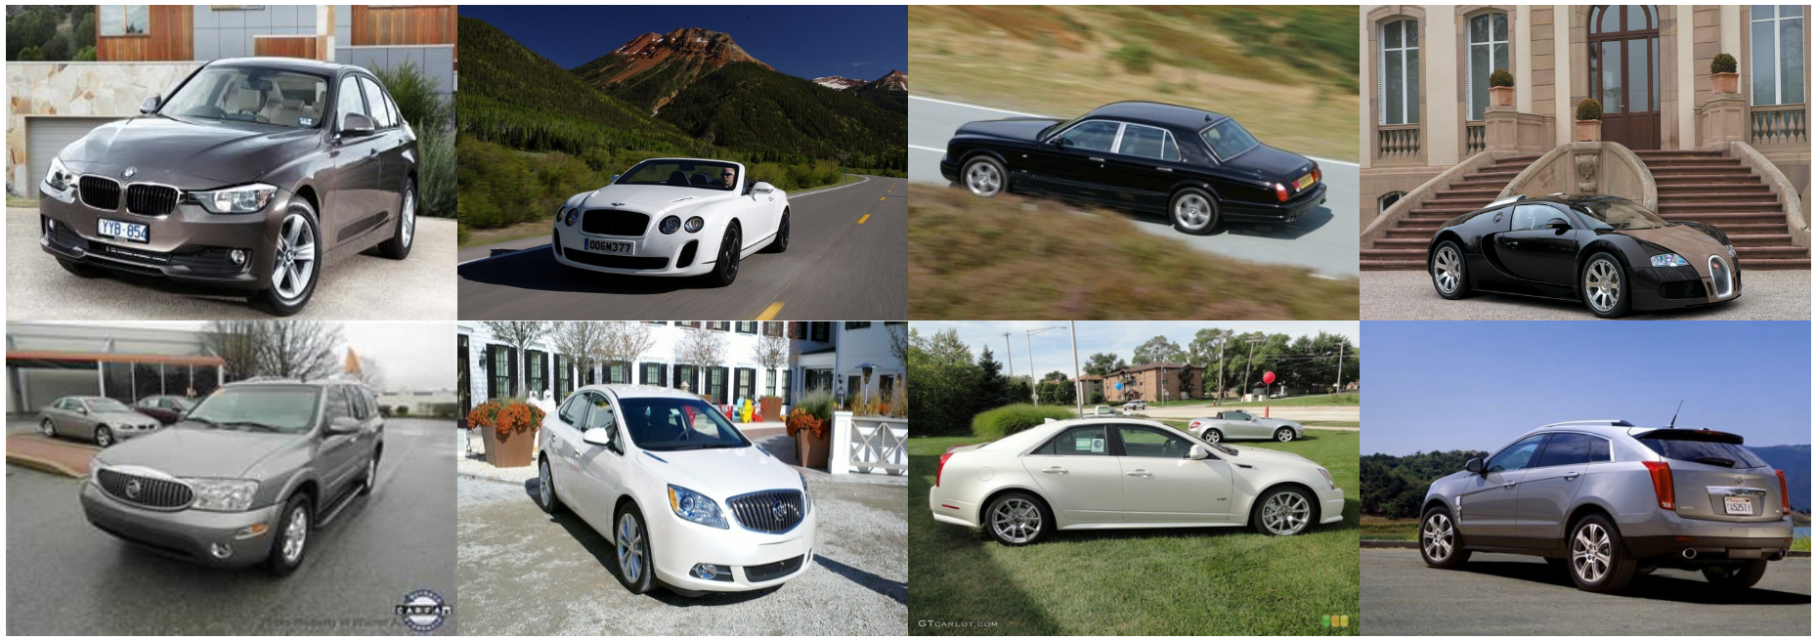
Stanford Car Dataset
The Cars dataset contains 16,185 images of 196 classes of cars. Classes are typically at the level of Make, Model, Year. A common problem is that the brands have different conventions which makes two similar cars very different in a model. Some of the models are discontinued which is hard to update.

Slide 7
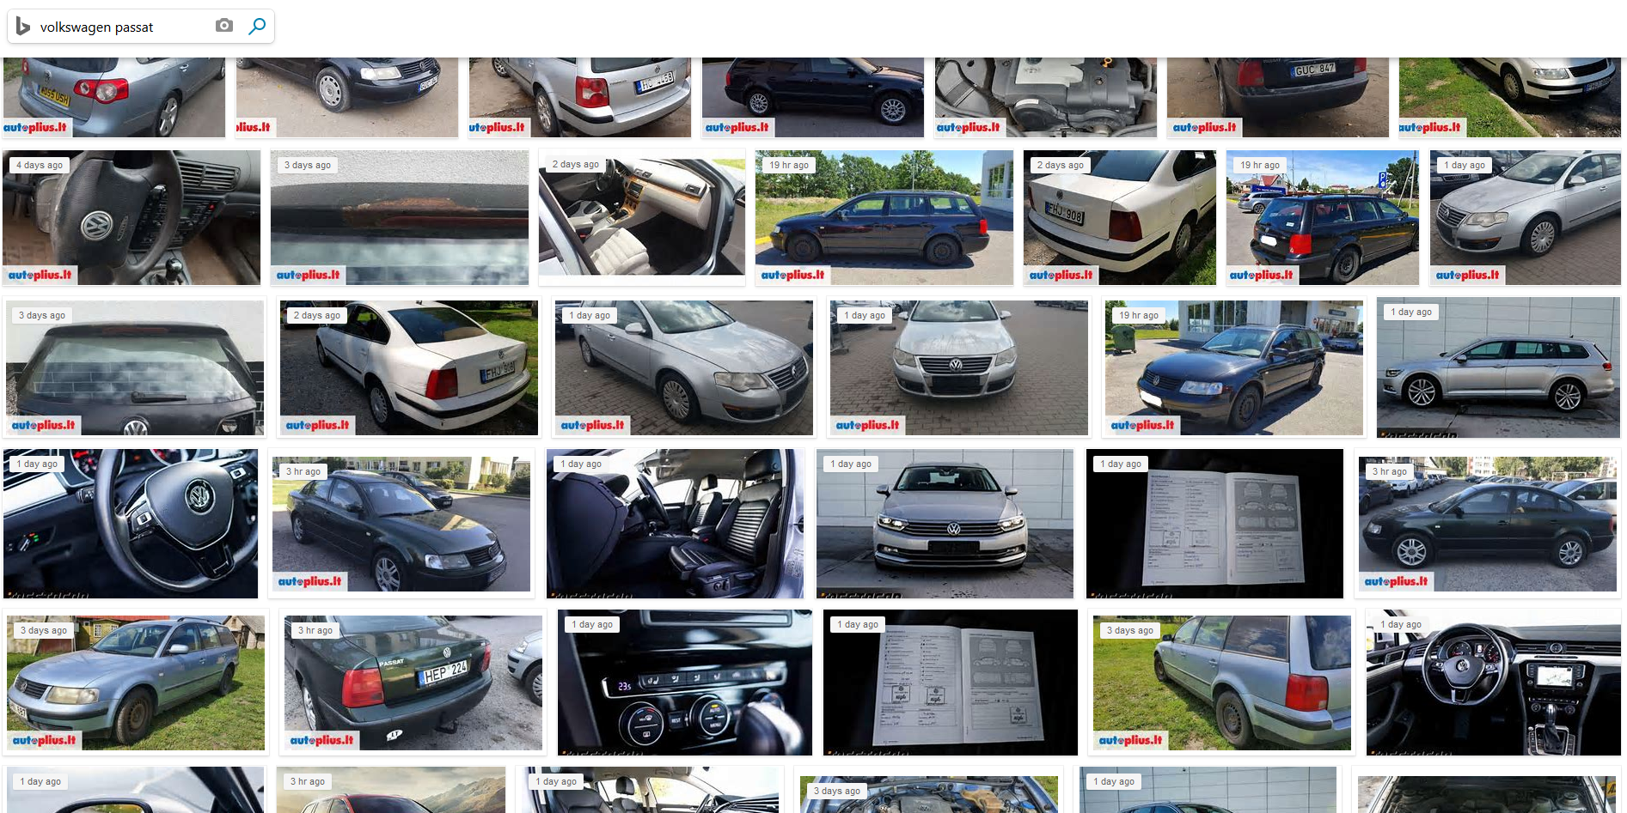
Bing Image Search API
Although it is a very rich source, a lot of images are also ending up being remotely related and passing the filter. To clean the data set a color term was added to search query and a color filter was applied to the search parameters. A second cleaning was done manually to select the photos that contained the features of a car model openly. Around 800 images were collected for each model (13) which built up to nearly 11000 images.

Slide 8
PROCESSING
In order to process the data we have we used the images to identify which cars we should pick to classify. For this process we looked at each car and their features.

Slide 9
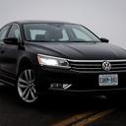
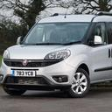
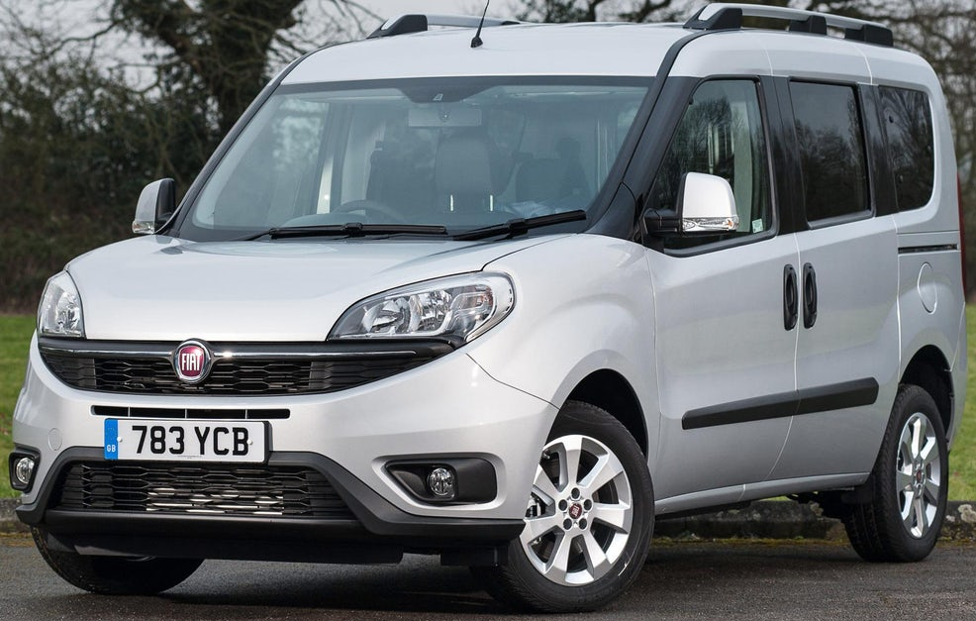
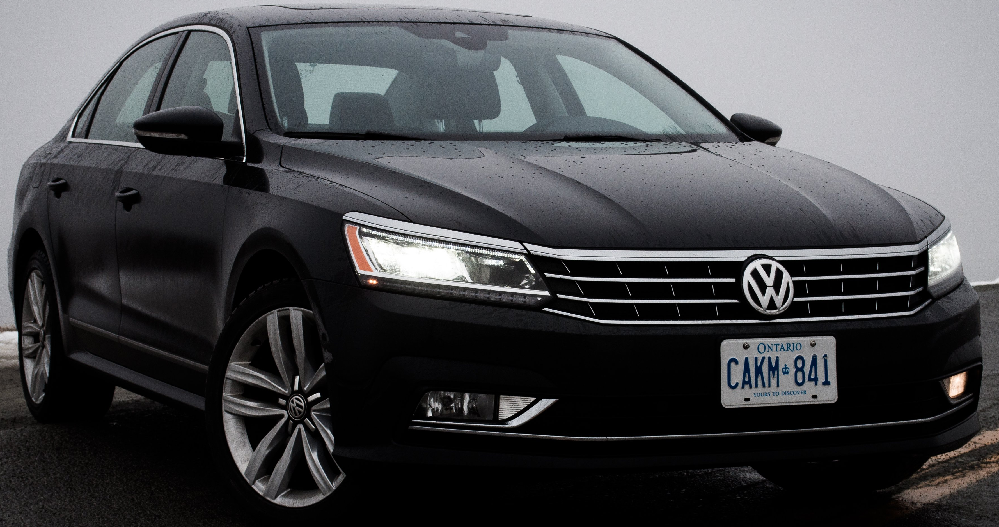
Processing

Slide 10
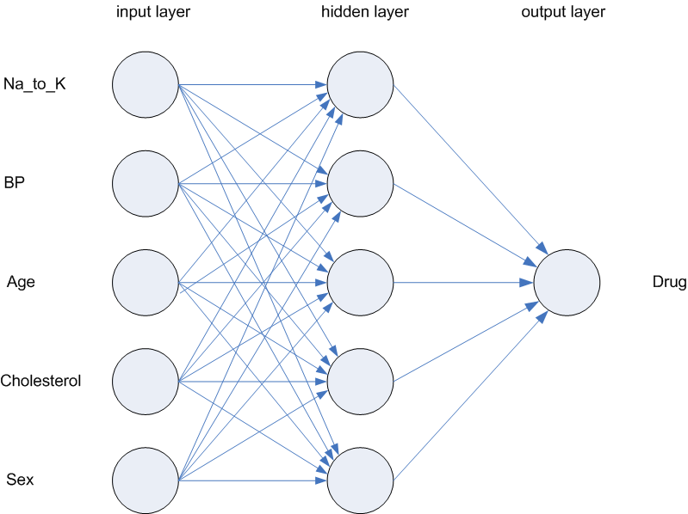
PROGRAMMING
We decided to use a deep neural network to identify cars. We picked our modules accordingly to incorporate machine and deep learning libraries and libraries that include easy ways to process

Slide 11
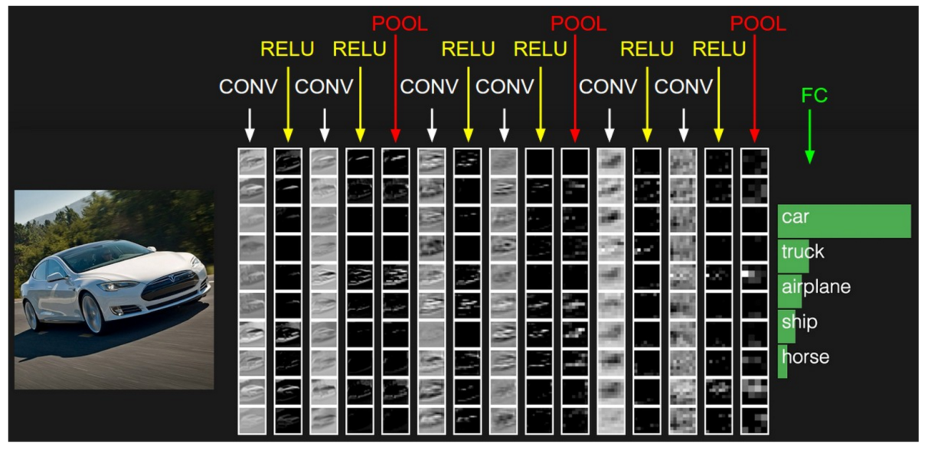
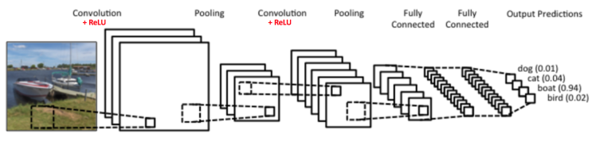
Convolutional Neural Networks
2D Convolution | 2D Convolution | 2D Convolution | Flatten Dense (64) ReLU Dropout (0.5) | Dense (1) Sigmoid
32 (Big portions of image) | 64 (Mid-sized portions) | 32 (Small features)
Rectified Linear Unit | Rectified Linear Unit | Rectified Linear Unit
Max pooling | Max pooling | Max pooling

Slide 12
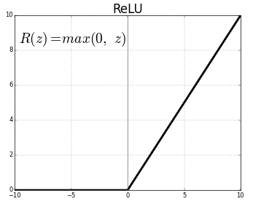
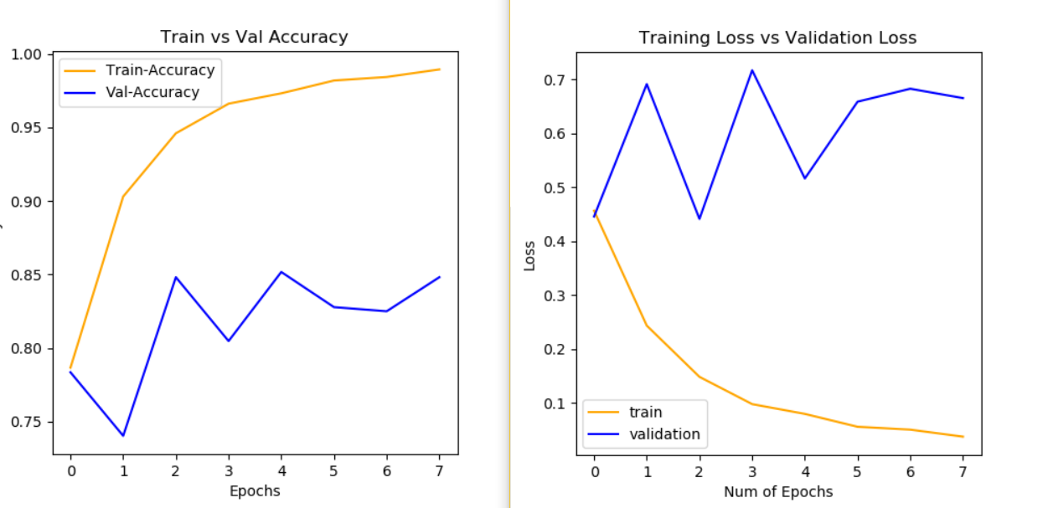
Hyperparameters for CNN

Slide 13
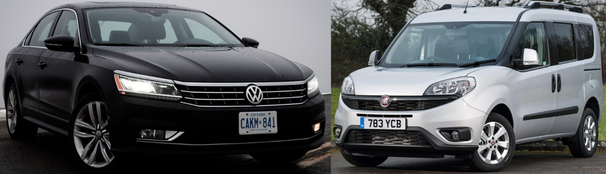
Convolution Sizes
The hyperparameters of layers of neural network should be arranged accordingly to achieve most accurate weights. To achieve these end results, we decided to first make the neural network look at the image in parts as big as possible.
This is related to the fact that two cars have different sizes and shapes.
In a deeper layer it should be able to extract a fairly smaller part, compared to layer before, that still is big considering the size of the image. This layer is supposed to differentiate between smaller details such as headlights, rims and rearview mirrors.

Slide 14
Modules
numpy: used to deal with large matrix data as it is an optimized library
pandas: providing fast, flexible data structures to work with structured (tabular, multidimensional) data
matplotlib: interactive graphing
seaborn: making statistical graphics
sklearn: machine learning

Slide 15
Modules
tensorflow: high performance numerical computation, allows computation on a variety of platforms (CPUs, GPUs, TPUs)
keras:
IPython: using Python interactively
PIL: opening, manipulating, and saving many different image file formats
Cv2(OpenCV): computer vision and machine learning software library
easy prototyping (modularity, and extensibility).
both convolutional networks and recurrent networks
runs on CPU and GPU

Slide 16
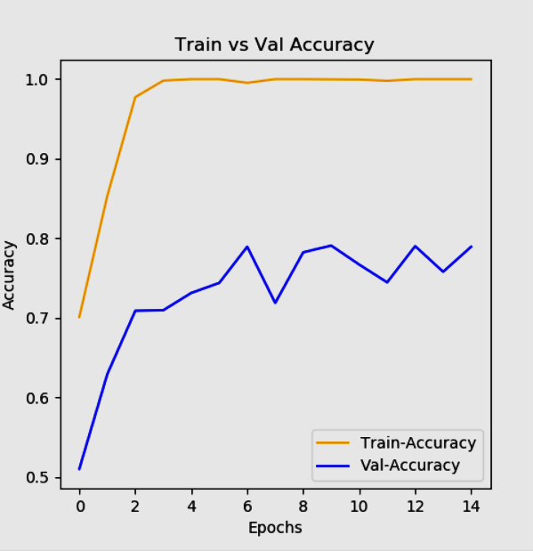
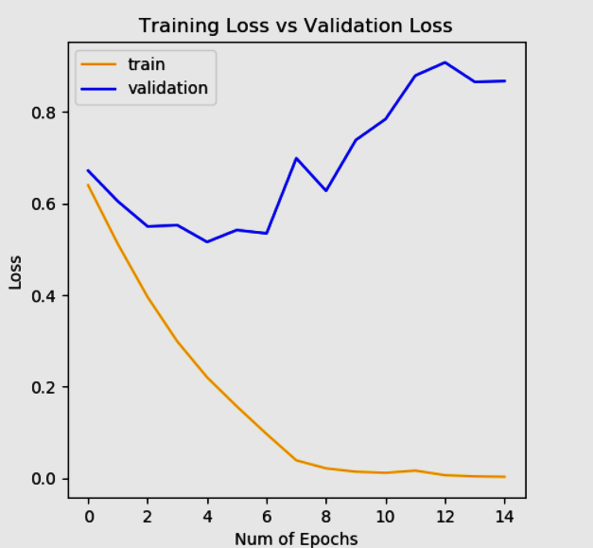
Progress

Slide 17
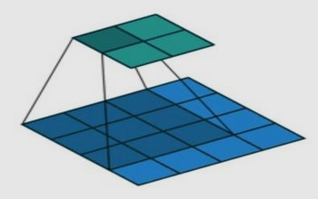
CONVOLUTIONAL NEURAL NETWORK
Computers see images using pixels. A certain group of pixels may signify an edge in an image or some other pattern. Therefore, we use convolution method to identify pictures. Convolution method basically multiplies specified pixels of a matrix with a filter matrix and then sums up the multiplied values. The same process continues until every pixel covered with the same size of the pixel matrix.

Slide 18
CHALLENGE
After deciding to make our own dataset, although the photos submitted by users helped us gather a large dataset, it was hard to filter images of cars that would yield a good training set. Another challenge was to decide on hyperparameters of the neural network that would yield the best results. After going through websites and articles we achieved a high accuracy result.

Slide 19
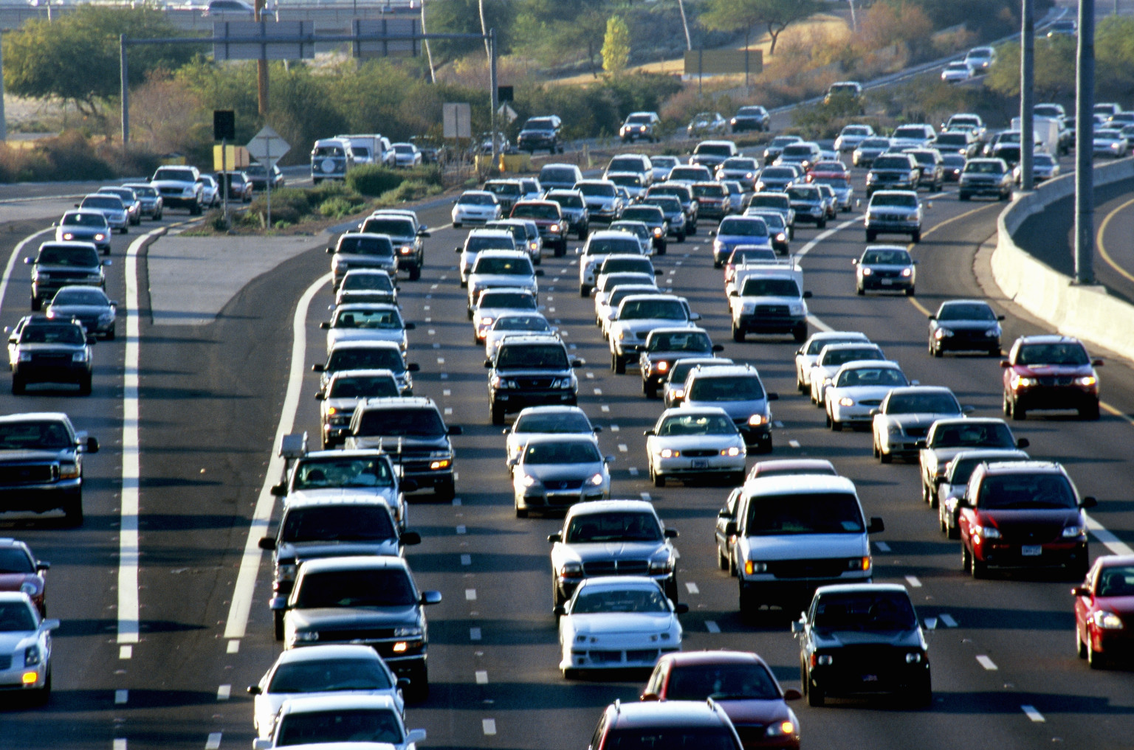
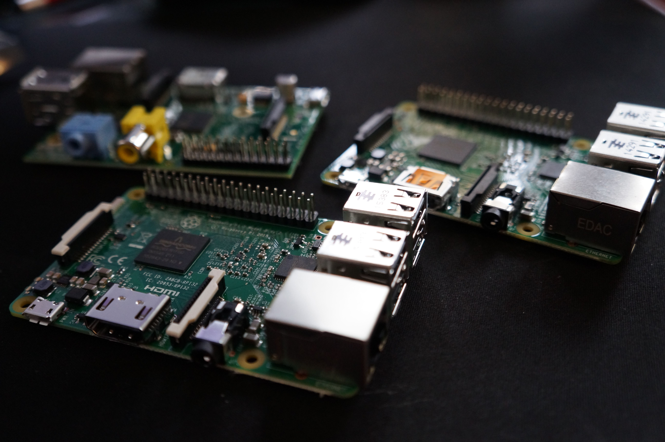
IMPROVEMENTS
If we had several more weeks, we could have trained the neural network to identify different brands and models of cars until eventually finishing most of the cars used in Turkey. A later step would be to use a Raspberry-Pi and camera to identify different cars in real time.

